Slide 1

Problem solving with trigonometry
Task A: Calculating areas
1) Calculate the area of each triangle, to 1 decimal place.
b)
b)
15°
h cm
h cm
82°
6 cm
6 cm
h = 3 × tan(82°) = 21.346…
h = 3 ÷ tan(15°) = 11.196…
Area = × 6 × 21.346… = 64.0 cm²
Area = × 6 × 11.196… = 33.6 cm²
c)
d)
h cm
12 cm
30°
12 cm
24°
7 cm
h cm
h = 7 × sin(24°) = 2.847…
h = 12 × sin(30°) = 6
Area = × 12 × 2.847… = 17.1 cm²
Area = × 12 × 6 = 36 cm²
2) Calculate the area of this rhombus, to 1 decimal place.
h cm
7 cm
73°
7 cm
h cm
h = 7 × sin(73°) = 6.694…
73°
Area = 7 × 6.694… = 46.9 cm²

Slide 2

Problem solving with trigonometry
3) Calculate the area of this parallelogram, to 1 decimal place, given that its perimeter is 54 cm.
h cm
66°
11 cm
b cm
Perimeter: 2b + 22 = 54
h = 11 × sin(66°) = 10.049…
2b = 32
b = 16
Area = 16 × 10.049… = 160.8 cm²
4) Calculate the area of this regular hexagon, to 1 decimal place.
5 cm
A possible method:
y cm
5 cm
x = 5 × cos(60°) = 2.5
5 cm
x cm
60°
y = 5 × sin(60°) = 4.33…
2y cm
Area of rectangle = (2 × 4.33…) × (5 + 2 × 2.5) = 86.602… cm²
120°
Area of 4 congruent triangles = 4 × × 2.5 × 4.33…= 21.650… cm²
(5 + 2x) cm
Area of hexagon = 86.602… - 21.650 = 65.0 cm²
2

Slide 3
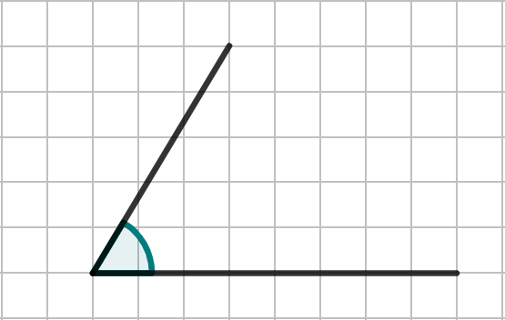
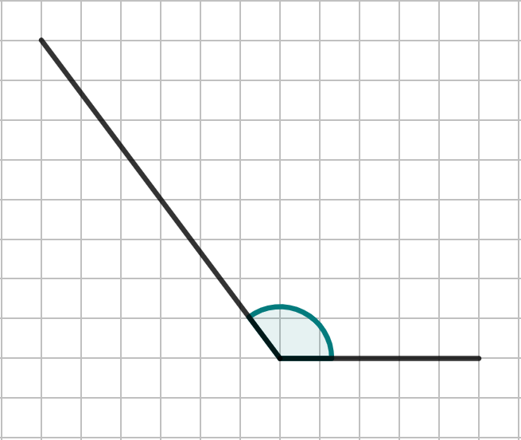
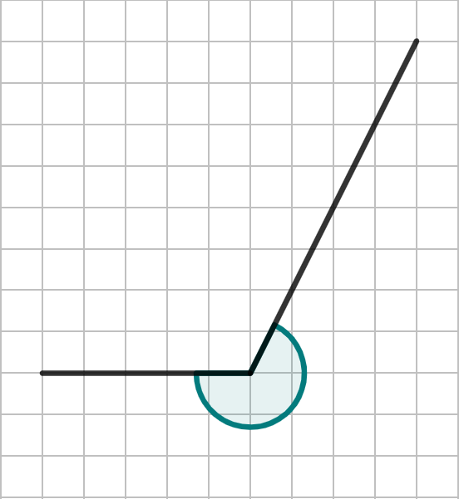
Problem solving with trigonometry
Task B: Calculating angles
1) Calculate the marked angles on each diagram.
a)
b)
c)
𝜃°
𝜃°
𝜃° = 59.0° (1 d.p.)
𝜃° = 126.9° (1 d.p.)
𝜃°
𝜃° = 243.4° (1 d.p.)
2) A yacht is given the instruction to sail 20 km due East and then 60 km due North. If the yacht is already facing East, what angle should it turn to be facing directly towards its final position?
60 km
tan(𝜃°) =
60
20
𝜃°
𝜃° = tan⁻¹(3)
20 km
𝜃° = 71.6° (1 d.p.)
3) A helicopter travels 30 km due North and then rotates 𝜃°, before travelling 50 km in that direction. The helicopter finishes directly due West of the starting point. What angle of turn did they make?
𝜃°
cos(⍺°) =
30
50
50 km
⍺° = cos⁻¹(0.6)
⍺°
30 km
⍺° = 53.13…°
𝜃° = 180 - ⍺ = 180 - 53.13… = 126.9°
Mathematics in Education and Industry
v2.3

